Slide 1
Analysis of Mortality Rate by Education Level, Age Group, and Location Using Azure Databricks
Module: COM745 – Big Data and Infrastructure Student Name: Aprem George Student ID: B01012093

Slide 2
Problem & Background
Educational attainment is widely recognised as a social determinant of health.
Mortality rates often vary significantly across education levels, age groups, and geographic regions.
Understanding these patterns at scale requires big data storage and distributed analytics.
Problem Statement: To analyse how mortality rates vary by education level, age group, and county-level location, and how these patterns changed between 2018 and 2019.

Slide 3
Dataset Selection & Relevance
Source: Institute for Health Metrics and Evaluation (IHME) (https://ghdx.healthdata.org/record/ihme-data/us-le-county-education-2000-2019)
Geography: United States (county level)
Years Used: 2018 and 2019
Population Stratification:
Education level
Age group
Location (county)
Why this dataset?
Large-scale, longitudinal public health data
Includes uncertainty bounds (lower, upper)
Suitable for multi-dimensional analysis in a data lake

Slide 4
Analytical Objectives
Examine the education gradient in mortality rates
Compare changes between 2018 and 2019
Identify age–education interactions
Highlight geographic inequalities in mortality outcomes
Demonstrate use of big data infrastructure rather than traditional databases

Slide 5
Overall System Architecture
Azure Databricks workspace deployed on Microsoft Azure
Spark-based distributed processing
Lakehouse architecture:
Bronze → Silver → Gold layers
SQL + PySpark used for analytics and visualisation
Why Databricks?
Scalability for large datasets
Integrated analytics, storage, and visualisation
Supports structured lakehouse workflows

Slide 6
Data Ingestion (Bronze Layer)
Raw IHME CSV datasets for 2018 and 2019 ingested
Files loaded into Databricks managed storage
Schema inferred using Spark
No transformation applied at this stage
Purpose: Preserve raw data for traceability and reproducibility

Slide 7
Data Cleaning & Transformation (Silver Layer)
Performed key cleaning operations:
Removed rows with:
edu_name = 'All educational attainment populations'
Missing mortality values (val IS NULL)
Converted mortality metrics to numeric types
Retained uncertainty bounds (lower, upper)
Dropped non-essential columns:
measure_id, location_id, sex_id, cause_id, metric_id, etc.
Outcome: Clean, analysis-ready dataset

Slide 8
Data Modelling (Gold Layer)
Created analytical aggregates:
Mortality rate by:
Education level
Age group
Location
Year-on-year comparison (2018 → 2019)
County-level ranking of lowest mortality rates
Gold tables enabled:
Fast querying
Clear visualisation
Insight-driven analysis

Slide 9
Scalability & Technology Justification
Spark handles millions of records efficiently
Queries execute in parallel across nodes
Easily extensible to additional years or countries
Alternative solutions (e.g., RDBMS) lack scalability and flexibility for this task

Slide 10
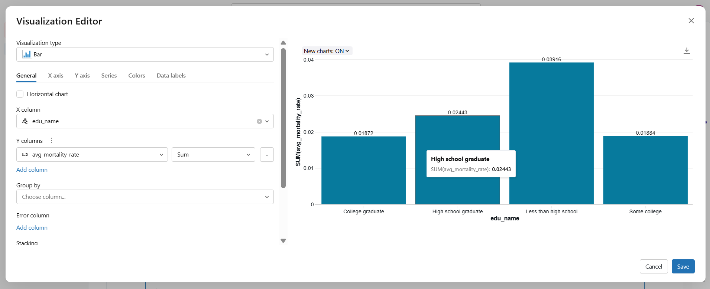
Insight 1: Education Gradient in Mortality
Key Observation:
Mortality rates decrease consistently with higher educational attainment
Individuals with less than high school education experience the highest mortality rates
College graduates show the lowest mortality rates
Interpretation:
Strong inverse relationship between education and mortality

Slide 11
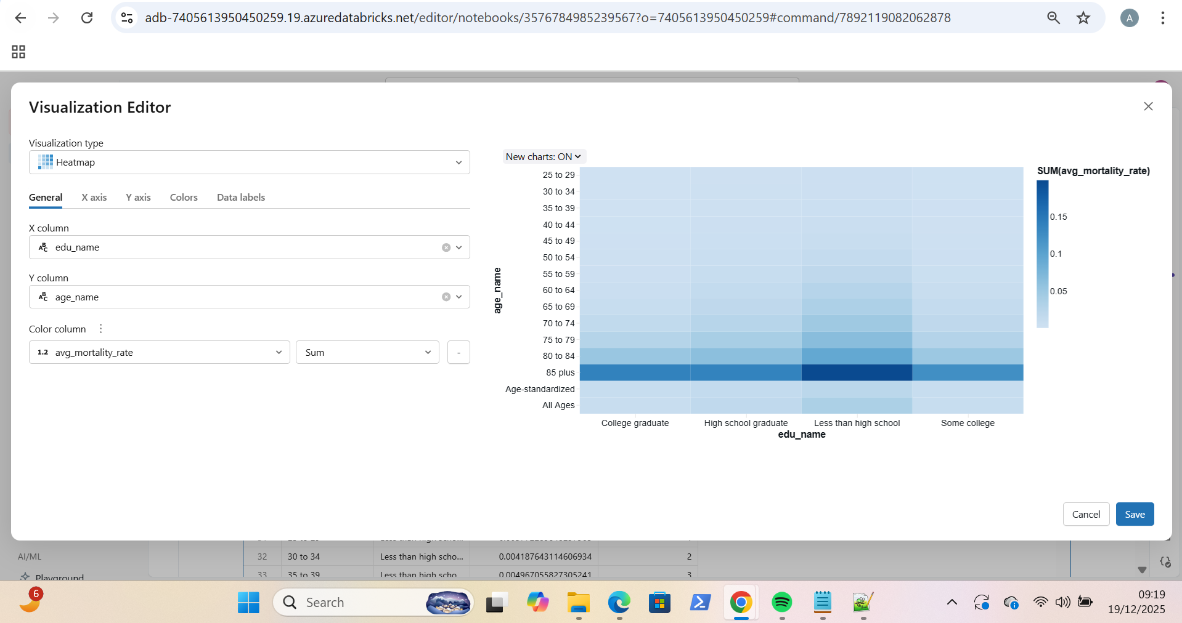
Insight 2: Age × Education Interaction
Key Observation:
Mortality increases sharply with age across all education levels
Education gradient persists at older ages
Largest disparities observed in 75+ age groups
Interpretation:
Education has a protective effect even later in life

Slide 12
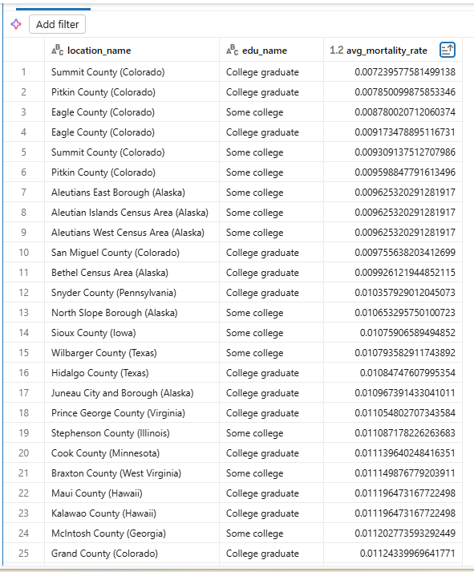
Insight 3: Geographic Inequality
Key Observation:
Certain counties consistently show lower mortality rates
Many low-mortality counties correspond to higher education levels
Geographic clustering of favourable outcomes is evident
Interpretation:
Location and education interact to shape health outcomes

Slide 13
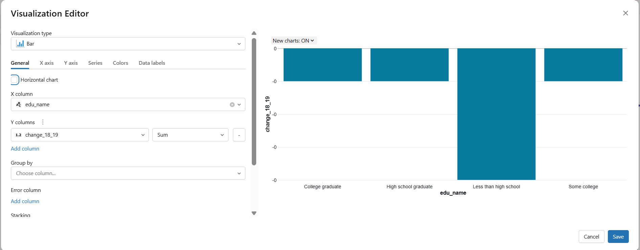
Insight 4: Change Between 2018 and 2019
Key Observation:
All education groups show slight changes in mortality rates
The largest magnitude of change occurs in the lowest education group
Changes are relatively small but consistent
Interpretation:
Mortality improvements or declines are uneven across education levels

Slide 14

Video Demonstration

Slide 15
Concluding Comments
Educational attainment shows a strong and persistent relationship with mortality
Age amplifies existing education-based disparities
Geographic location further influences mortality outcomes
Azure Databricks proved effective for scalable health data analysis
Limitations & Future Work:
Extend analysis to additional years
Include socioeconomic variables such as income
Apply predictive modelling for future mortality trends

Slide 16
References
[1] Institute for Health Metrics and Evaluation (IHME), United States Mortality by Education and County, 2000–2019, Public Use Dataset, 2023. [Online]. Available: https://ghdx.healthdata.org
[2] Microsoft, Azure Databricks Documentation, Microsoft Learn, 2025. [Online]. Available: https://learn.microsoft.com/azure/databricks
[3] Apache Software Foundation, Apache Spark SQL, DataFrames and Datasets Guide, 2025. [Online]. Available: https://spark.apache.org/sql
[4] M. Marmot et al., “Social determinants of health inequalities,” The Lancet, vol. 365, no. 9464, pp. 1099–1104, 2005, doi: 10.1016/S0140-6736(05)71146-6.
[5] World Health Organization, Social Determinants of Health, WHO, 2023. [Online]. Available: https://www.who.int/teams/social-determinants-of-health

